Slide 1

Study: Little Albert (Watson and Rayner 1920)
ATPSY Year 12 ATAR Psychology

Slide 2

Review
Exam Questions:10 minutes

Slide 3
Learning Intentions
study: ‘Little Albert’ experiment (Watson and Rayner, 1920)

Slide 4
Success Criteria
Apply principles of classical conditioning to the Little Albert Experiment
List strengths and limitations of the Little Albert Experiment
(Appreciate why we have ethical considerations for psychology experiments now)

Slide 5
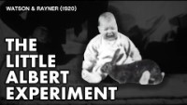

Slide 6
Success Criteria
Apply principles of classical conditioning to the Little Albert Experiment
List strengths and limitations of the Little Albert Experiment
(Appreciate why we have ethical considerations for psychology experiments now)

